Slide 1
Waste management – citizens engagement
Github repository: https://github.com/marios-stam/Project_IOT
Fragiskos Fourlas (1059336)
Marios Stamatopoulos (1059383)
Nikos Panagiotopoulos (1053552)

Slide 2
OUTLINE
Problem
Solution
Market Fill
Market Gap
Our Proposal

Slide 3
Workload Allocation
Gateways/Devices, Prediction, Reward System
(Fragiskos Fourlas)
Optimal Route, Server Structure, Database
(Marios Stamatopoulos)
Frontend Design and Structure, Data Analysis
(Nikos Panagiotopoulos)

Slide 4
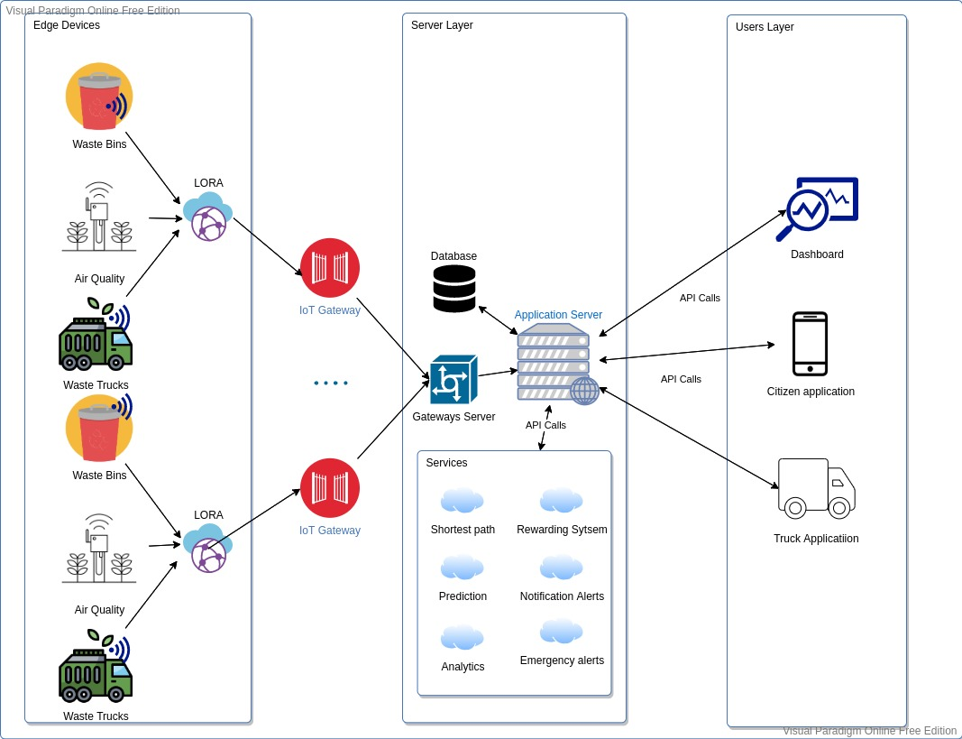
Our Proposal

Slide 5
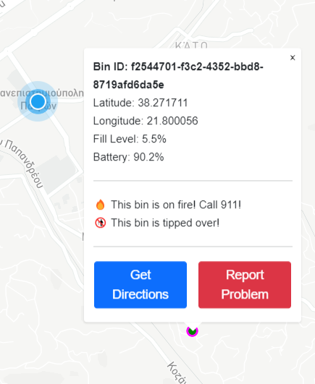
Dummy Sensors
Dummy Sensors Server
Collects data from the gateway and publishes it to the server
Handles API calls for I/O
Sensor Gateway
Works in the place of an actual IoT Gateway
Runs processes containing sensors
Transfers messages between sensors and server via pipes
Sensors
Have a unique identifying UUIDv4
Scatter themselves around a fixed center point
Update and publish mock data with a unique “measurement ID” each interval
Chance to fall or catch fire every interval

Slide 6
SERVER
FLASK FRAMEWORK
SQL ALCHEMY
Handling all HTTP requests from and to services
Sensors gateways
Front-end
Rewarding system, Fleet routing optimization , Bounties
Implemented all functions that interface with Database needed for front-end and the other services

Slide 7
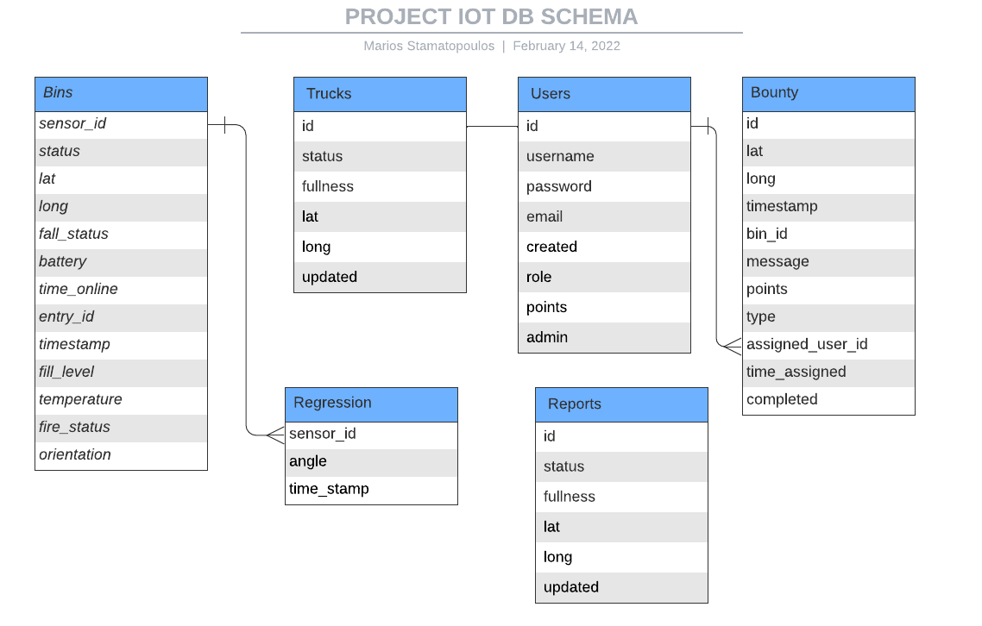
Database schema

Slide 8
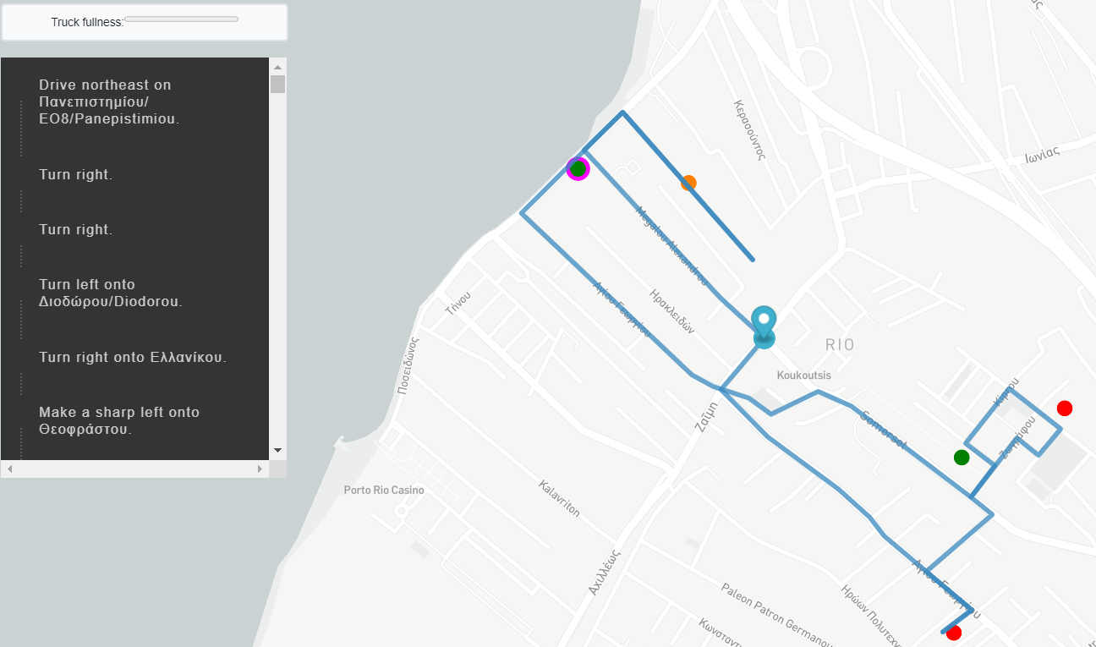
TRUCK FLEET ROUTING
Check all available trucks at the moment
Check all bins that need pickup
Transform it into travelling salesman problem (GraphHopper API)
Each truck is assigned to specific bins
Calculating directions for every truck and send them as JSON (Mapbox API)

Slide 9
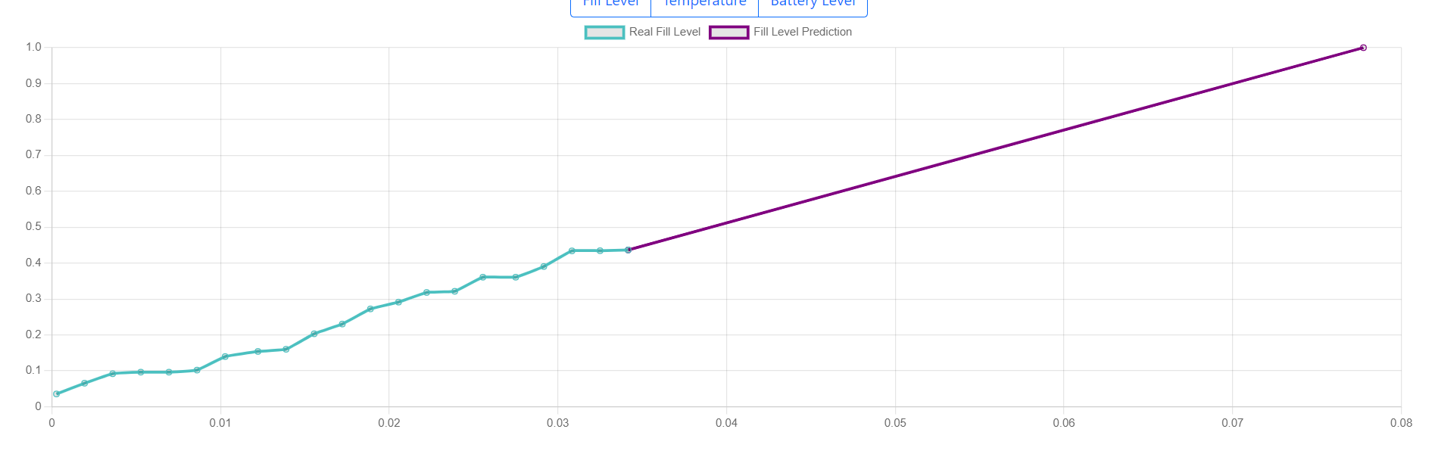
Regression Prediction
Uses measurement history to predict a fill rate
Prediction is calculated per sensor and saved individually in a DB table
If retrieved regression model is too old, prediction is recalculated and updated before response

Slide 10
Citizen Engagement – Point System
Announce Bounty
(e.g. Tilting bin, Empty battery)
Award Points
Citizens Redeem for Vouchers

Slide 11
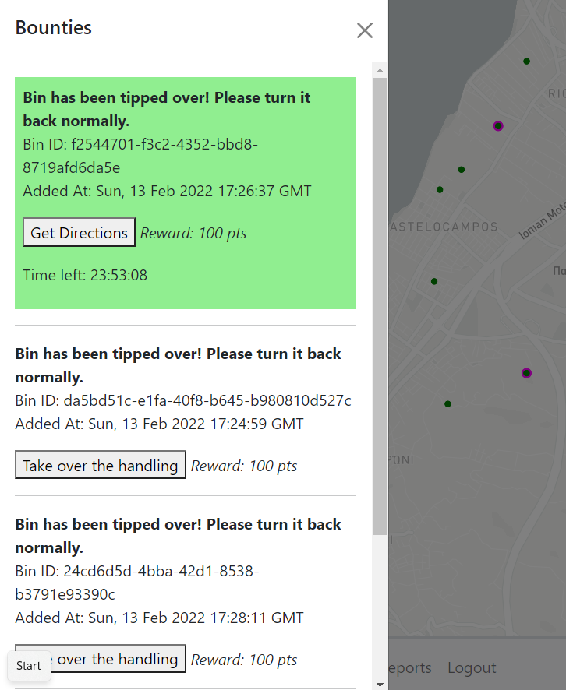
Bounties
Generation
A bounty is automatically generated when a bin makes a problematic measurement
Support for future development: Admin generated bounties for any purpose
User Interaction
User can find bounties in a radius around him
User accepts a bounty and has some time to complete it
User can find a list of his assigned bounties in his profile, mark it complete and receive the reward points or abandon

Slide 12
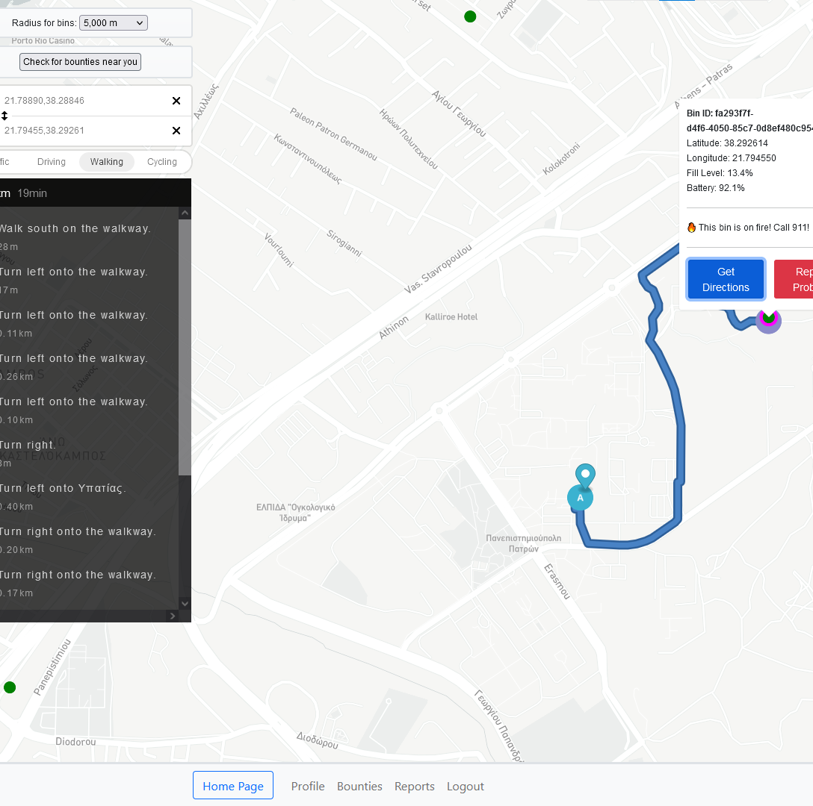
Citizens’ App
Retrieve and track user location
Control radius of bins rendering
Repeatedly checking for bounties
Get directions for specific bin
Draw bins according to fill level
Emphasize bins that have problems
Show detailed info for specific bin
Library used: Mapbox GL JS

Slide 13
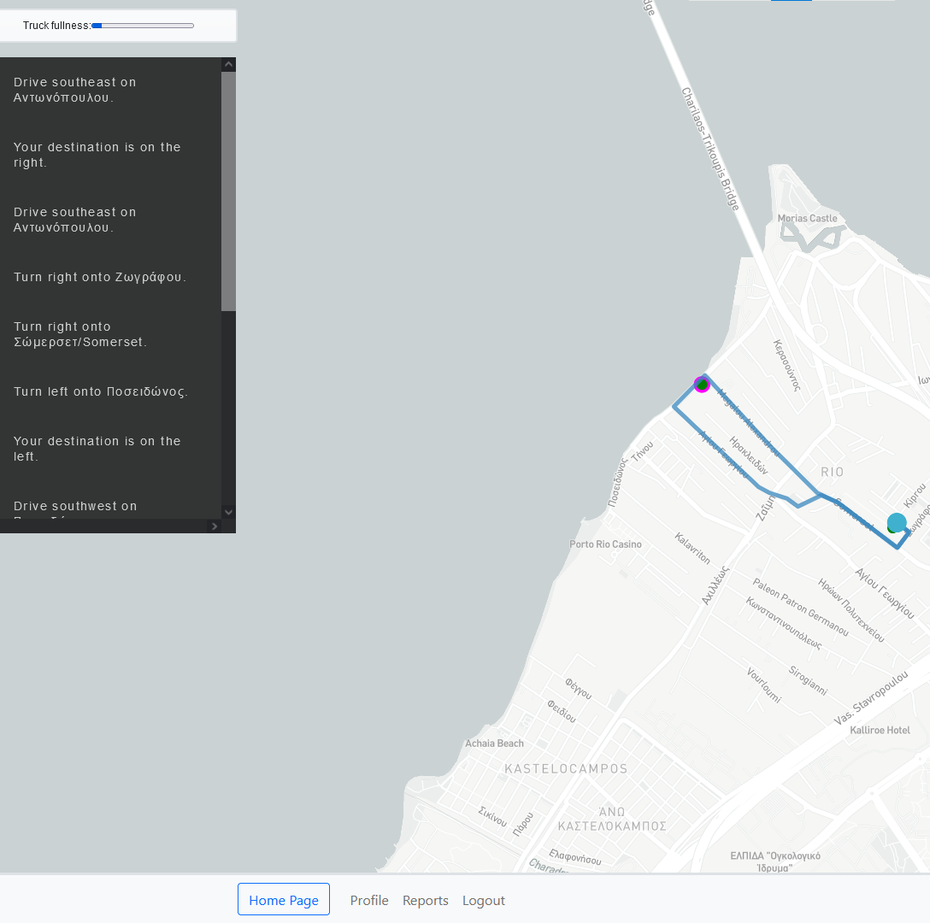
Drivers’ App
Set origin and destination at depot
Repeatedly checking truck’s fullness
Notify driver if this truck must be used
Draw the retrieved optimal route
Custom display of directions
Draw bins according to fill level
Info and report problem for bin
Library used: Mapbox GL JS

Slide 14
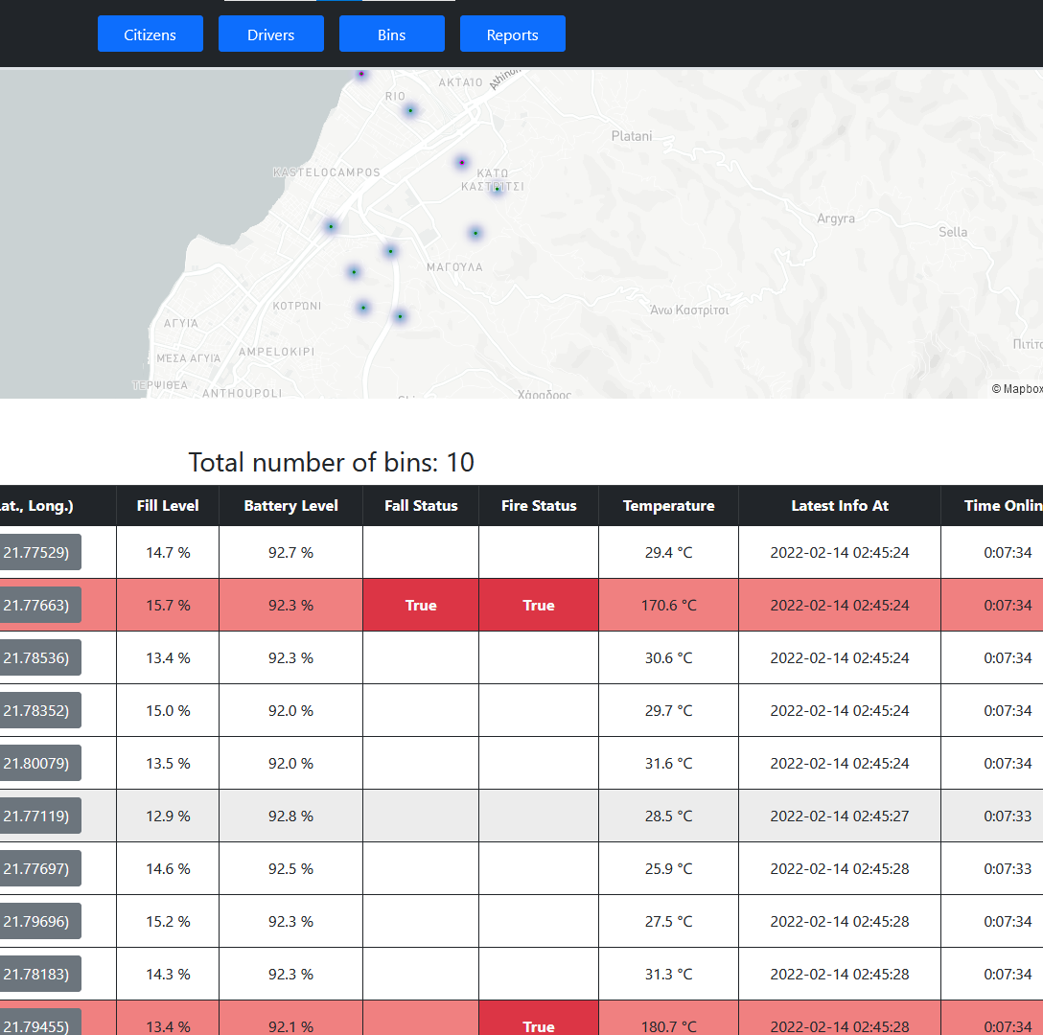
Bins Dashboard
View heatmap of all bins
Detailed info about each bin
Paginated dynamic list of all bins
Get last n measurements for each bin
Get prediction of time-to-fill
Charts of fill level, temperature, battery
Libraries used: Mapbox GL JS, Chart.js

Slide 15
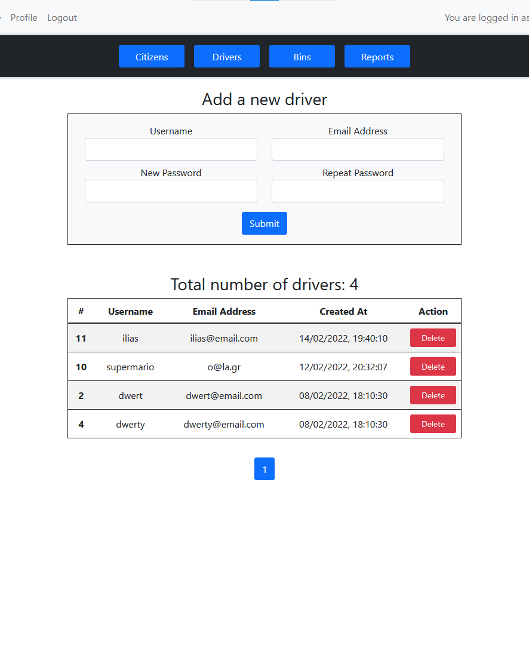
Rest of UI Operations
Registration and user sessions
Authentication-authorization
Forms validation and protection
View/edit/delete profile
Assume bounties, view pending
Create/view reports
Overview citizens engagement
Manage driver accounts
View/confirm/reject reports

Slide 16
Known Issues
Major
The maximum number of bins per route is 25 due to the limitation of the free version of Grasshoper API
Minor
Buttons on home page do not work, need to press “CleanerCity App” on the nav-bar
Fill level on bin history graph doesn’t display x-axis time
Some visuals don’t auto refresh

Slide 17

Questions?

